Slide 2
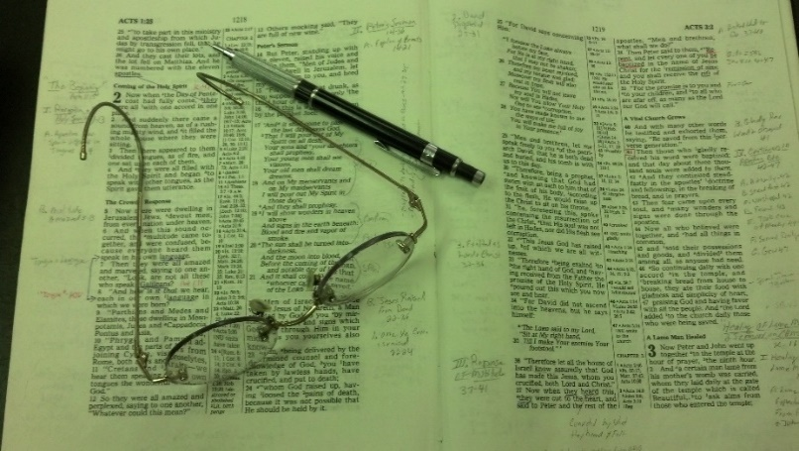
Topics
Day Classes
Monday: Who is the Greatest? (Matt. 18:1-9)
Wednesday: When You’ve Been Wronged (Matt. 18:10-20)
Friday: Forgiveness (Matt. 18:21-35)

Slide 3
Matthew 18
Relationships

Slide 4
Problems In Relationships Come Because
Focus on self
Pride
Don’t Value Another
Don’t Resolve Differences
Fail to Forgive
(cf. Matt. 17:23 - 18:1)
(Matt. 18:4)
(Matt. 18:10-14)
(Matt. 18:15-17)
(Matt. 18:21-35)
Jesus Dealt
With All These

Slide 5
Matthew 18:1-9
Who Is The Greatest?
1 At that time the disciples came to Jesus, saying, "Who then is greatest in the kingdom of heaven?"
2 Then Jesus called a little child to Him, set him in the midst of them,
3 and said, "Assuredly, I say to you, unless you are converted and become as little children, you will by no means enter the kingdom of heaven.
4 Therefore whoever humbles himself as this little child is the greatest in the kingdom of heaven.
5 Whoever receives one little child like this in My name receives Me.

Slide 6
6 "But whoever causes one of these little ones who believe in Me to sin, it would be better for him if a millstone were hung around his neck, and he were drowned in the depth of the sea.
7 Woe to the world because of offenses! For offenses must come, but woe to that man by whom the offense comes!
8 If your hand or foot causes you to sin, cut it off and cast it from you. It is better for you to enter into life lame or maimed, rather than having two hands or two feet, to be cast into the everlasting fire.
9 And if your eye causes you to sin, pluck it out and cast it from you. It is better for you to enter into life with one eye, rather than having two eyes, to be cast into hell fire.

Slide 7
33 Then He came to Capernaum. And when He was in the house He asked them, "What was it you disputed among yourselves on the road?"
34 But they kept silent, for on the road they had disputed among themselves who would be the greatest.
35 And He sat down, called the twelve, and said to them, "If anyone desires to be first, he shall be last of all and servant of all."
36 Then He took a little child and set him in the midst of them. And when He had taken him in His arms, He said to them,
37 Whoever receives one of these little children in My name receives Me; and whoever receives Me, receives not Me but Him who sent Me."
Mark 9:33-37

Slide 8
46 Then a dispute arose among them as to which of them would be greatest.
47 And Jesus, perceiving the thought of their heart, took a little child and set him by Him,
48 and said to them, "Whoever receives this little child in My name receives Me; and whoever receives Me receives Him who sent Me. For he who is least among you all will be great."
Luke 9:46-48

Slide 9
Matthew 18:1-9
Who Is The Greatest?
I. The Question (v. 1)

Slide 10
A. What Prompted Such A Question?
1. Misunderstanding of nature of kingdom (cf. Lk 22:24-27)
2. Position and power have always been attractive to humanity (cf. Mt. 20:20-21; Mk 10:35-37)
3. Immediate circumstances in context:

Slide 11
Immediate Circumstances
In Context:
a. Jealousy has been growing (cf. Statement to Peter - 16:17-18)
b. Shortly before - Jesus took 3 to mt. of transfig. - 9 not allowed (17:1-13)
c. Question directed to Peter (17:24)
d. Peter appointed to special miracle (17:24-27)
e. Discussion about earthly kings (17:24-27)

Slide 12
A. What Prompted Such A Question?
1. Misunderstanding of nature of kingdom (cf. Lk 22:24-27)
2. Position and power have always been attractive to humanity (cf. Mt. 20:20; Mk 10:35)
3. Immediate circumstances in context:
4. Motivated by “What is in it for me?”

Slide 13
A. What Prompted Such A Question?
B. How Disappointing Question
Must Have Been To Jesus

Slide 14
Disappointed Jesus
1. Jesus never preached self-advancement, rather always preached and lived humility.
2. Never a greater pattern of humility than he.
3. Spoke little of his glory, much about his suffering. They ignored his suffering and focused on the glory.
4. Recently taught them self denial (16:24)
5. The fact that ask the question shows they have no idea what the kingdom was.
6. They had some shame (Mk. 9:33-34)
They are behaving like
school-yard children!

Slide 15
A. What Prompted Such A Question?
B. How Disappointing Question
Must Have Been To Jesus
C. We Could Be Asking The Same Question

Slide 16
We would never think of asking
that same question!
Who
Is
The
Greatest
In
The
Kingdom?
Any question, action or
statement driven by
selfish ambition
Any attitude of “What is in it
for me?”
When focus on self - little
concern for others
Any jealousy or envy

Slide 17
Matthew 18:1-9
Who Is The Greatest?
I. The Question (v. 1)
II. The Answer (vv. 2-4)

Slide 18
A. Set a Child in Their Midst (v. 2)
1. What a surprising answer! A Child!
(a.) In midst (Matt)
(b.) In his arms (Mark)
(c.) By him (Luke)
2. Must have expected a discussion of their names
yet he talks about a child!
3. A child surrounded by 12 grown men must have
looked insignificant.
That was his point!

Slide 19
A. Set a Child in Their Midst (v. 2)
B. Be Converted (v. 3)
1. Not speaking of “conversion” - Obedience
2. “You’ve got to change”
(a.) Complete change in your thinking
(b.) Give up your selfish ambition, pride, etc.
(c.) Your attitude is all wrong
(d.) Whole premise is flawed!

Slide 20
A. Set a Child in Their Midst (v. 2)
B. Be Converted (v. 3)
C. Be Humble (v. 4)

Slide 21
1. Means: “bring low” (Strongs) “to reduce to a plain…to bring down one’s pride” (Thayer)
2. Strikes at heart of their pride & ambition
3. “As a child”
(a.) Child does not lift himself above others
(b.) Child accepts others / dependant
(c.) Child does not hold grudges
4. Mark of Greatness
5. Hard to do - “looking down on others is easy - hard to look down on yourself.”
"humbles himself"

Slide 22
Without Humility
You Will Not Even Get In
The Kingdom
Let Alone
“Having Big Places In It”
(Barnes)
"humbles himself"

Slide 23
Matthew 18:1-9
Who Is The Greatest?
I. The Question (v. 1)
II. The Answer (vv. 2-4)
III. The Warning (vv. 5-9)

Slide 24
Jesus Addresses Two Possible Fears:
If I humble myself
I will not be accepted
If I humble myself
I will be abused
“Little One” = Humble Disciple
A. Receive One Another (v. 5)

Slide 25
A. Receive One Another (v. 5)
Means: Receive, encourage, approve, love, & treat with kindness
To receive one is humility
Way treat others is way treat Christ
If cease looking out for self & look at others - will not suffer, but will be blessed

Slide 26
Jesus Addresses Two Possible Fears:
If I humble myself
I will not be accepted
If I humble myself
I will be abused
“Little One” = Humble Disciple
A. Receive One Another (v. 5)
B. Don’t Offend Another (vv. 6-9)

Slide 27
B. Don’t Offend Another (vv. 6-9)
Offend:
Not hurt feelings / think shouldn’t have…
Cause or lead to sin
How Offend:
Encourage sin - “you ought to…”
Defending one in sin - “he had to…”
Cause one to feel rejected….
Contentions give offense
Consequences of offending -
Better that a millstone (turned by a donkey)
Hell

Slide 28
Matthew 18:1-9
Who Is The Greatest?
I. The Question (v. 1)
II. The Answer (vv. 2-4)
III. The Warning (vv. 5-9)

